Slide 1
Community Pulse
Connecting Neighborhoods Through Local Events
Our Hackathon Project for
Compassion-A-Thon 2.0 ~ Paradox’25
Organised by Indian Institute of Technology, Madras
Team- Sree Chakra Reddy, Aryan Dev, Anirudh, Ayushman (Team-302)

Slide 2
The Problem We Set Out to Address:
Communities today lack a simple, centralized, and location-aware platform to share or discover local events like garage sales, sports matches, workshops, clean-up drives and many more.
As a result:
People miss out on nearby events they would love to attend or support.
Event Organizers struggle to reach a relevant audience.
Communication happens through scattered, untrustworthy platforms like posters and WhatsApp groups.
Verified organizers and community trust signals are missing.
No reminders or real-time updates lead to low attendance.

Slide 3
Our Approach to Reconnecting Communities: Community Pulse
Observing local life, there comes a common problem: people often live in the same area but feel completely disconnected. Events like a nearby yoga class, a street cricket match, or a donation drive often happen without most people even knowing.
In many neighborhoods, people live close together but remain strangers. Local events like art workshops, cleanup drives, or friendly sports matches often go unnoticed- because there’s no simple way to share or discover them.
Our creation Community Pulse aims to change that. It offers a space where people can post and find local happenings effortlessly, without the mess of social media or complicated sign-up processes. By making local engagement easy, accessible, and trusted, Community Pulse helps transform disconnected neighborhoods into vibrant, active communities.

Slide 4
The Core Features That Power Community Pulse
Community Pulse is designed with simplicity and impact in mind. It offers all the essential tools
users and admins need to participate in or manage local events without unnecessary friction.
Posting events is easy and quick — anyone can share local happenings like clean-up drives,
sports matches, or workshops without hassle.
No complex forms — people can show interest in attending with just their name, email, and
phone number.
Reminders that matter — attendees get timely updates via notifications, email, or SMS, so
they don’t miss what they care about.
A safer space for communities — admins can review and approve events to make sure
everything stays relevant and respectful.
Browsing made simple — events are neatly categorized, so users can explore what interests
them with just a few taps.

Slide 5
The Technology Behind Community Pulse
To bring the concept of Community Pulse to life, we chose technologies that allowed us to build quickly, stay flexible, and deliver a smooth experience to users. Each tool we used helped us focus on what mattered most: connection, clarity and easiness.
Frontend:
Built using React for a responsive and user-friendly interface, accessible on
both desktop and mobile.
Backend:
Powered by Node.js and Express, managing user data, event details, an
interactions efficiently.

Slide 6
Database:
Used MongoDB for flexible storage of event and user
information, supporting real
time updates.
Authentication:
Implemented Firebase Auth to handle secure user
login and organizer verification.
Hosting:
Deployed using Netlify for fast and reliable performance.

Slide 7
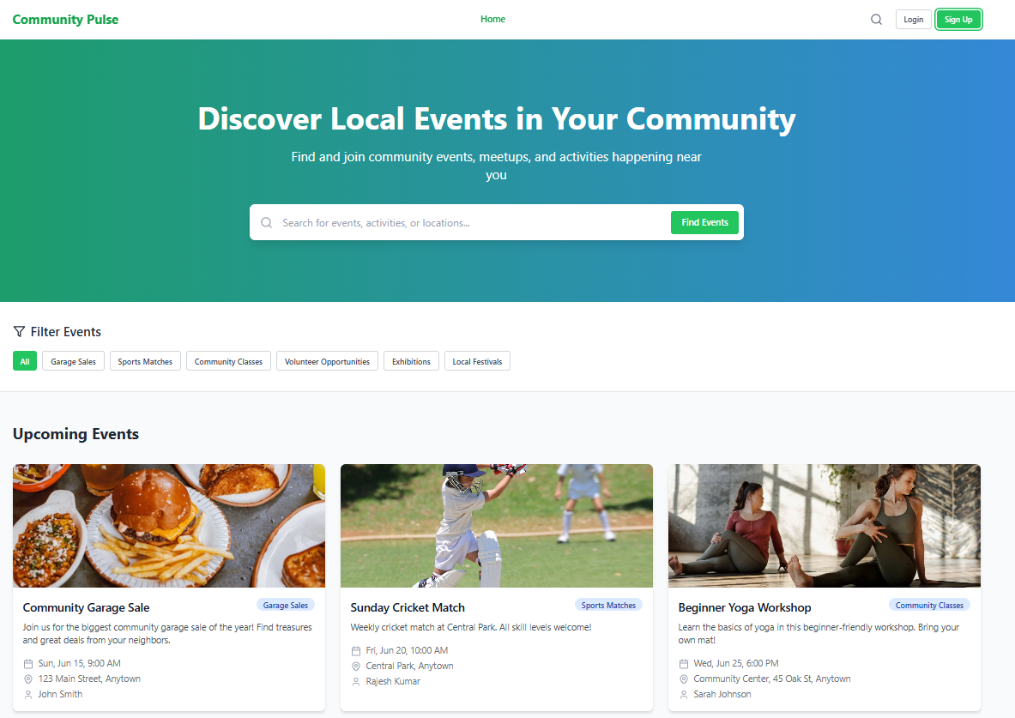
When users open the platform, they land on a homepage that highlights featured events and suggests nearby activities tailored to their location.

Slide 8
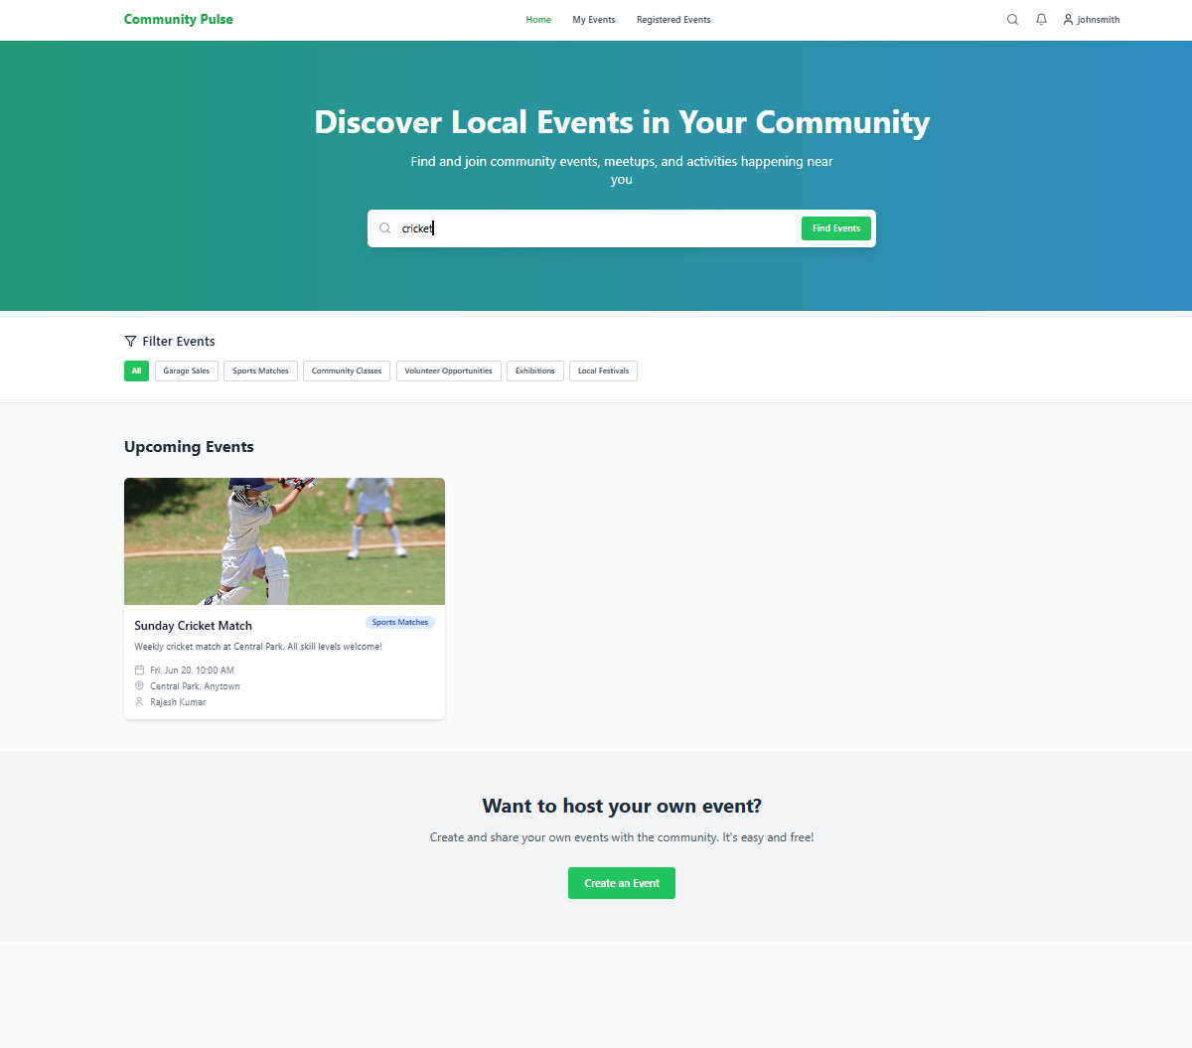
Using search bar, user can easily access the events which he wants to register in (events finder)

Slide 9
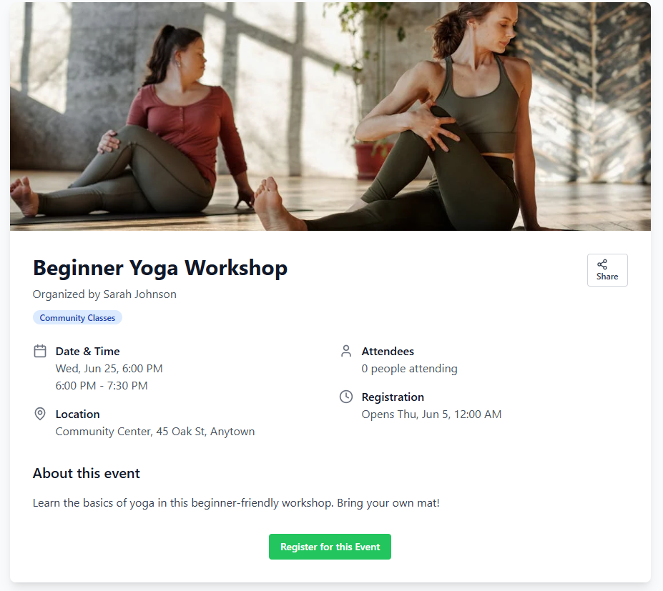
By clicking on an event, users can view detailed information including the event description, time, location, and organizer details.

Slide 10
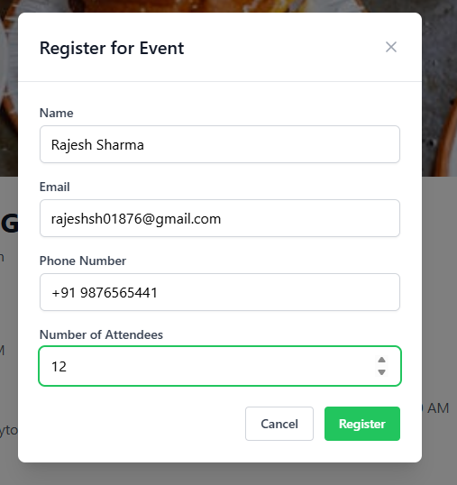
To express interest in an event, users fill out a brief form with their name, email, phone number, and the number of attendees.

Slide 11
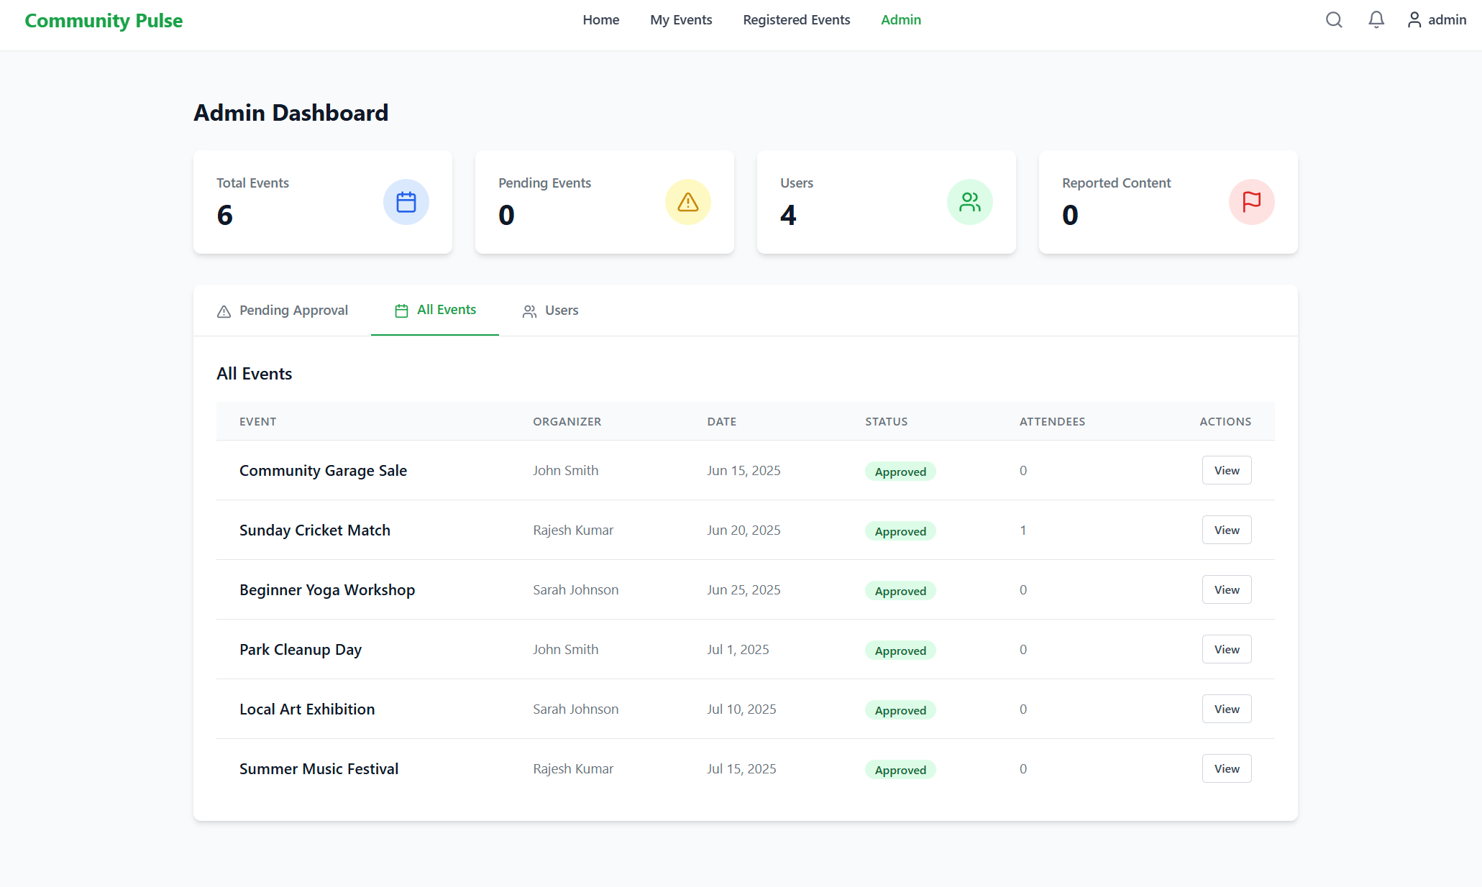
Admin Flow

Slide 12
Future Improvements Leave space to describe any future goals or enhancements.
Push Notifications
Event rating & feedback
Event filtering by distance
Calendar integration

Slide 13
Conclusion: Building Stronger Communities, Together
Community Pulse bridges the gap between neighbors by transforming how local events are shared and discovered. With its intuitive design, trusted verification, and real-time updates, our platform empowers communities to foster meaningful connections right where they live. By simplifying engagement, we’re not just creating a tool—we’re reigniting the spirit of togetherness. Join us in shaping vibrant, connected neighborhoods for the future.

